Slide 1
Social Media Driven Big Data Analysis for Disaster Situation Awareness
Group 16: Manish – 122AD0029
Dinesh – 122AD0041
Bala – 122AD0048

Slide 2
Problem Statement
Objective: Detect disaster-related tweets from social media.
Challenges:
Noise in text (emojis, URLs, slang).
Classifying disaster vs. non-disaster tweets.
Spatial Clustering
Scalability for large datasets.
Sentimental Analysis

Slide 3
Solution Overview
Approach:
Distributed processing with Apache Spark.
NLP techniques for text cleaning.
Spatial Clustering for disaster location identification and outliers.
Machine Learning techniques for classification.
Outcome:
Automated disaster identification system.
Sentiment Analysis, Weather it is High, Medium , Low severarity.

Slide 4
Addressing Limitations in Disaster Tweet Analysis
🛰 Spatio-Temporal Uncertainty
Issue: Many users disable location tracking → Missing/inaccurate geo-tags
Issue: Tweets may refer to past events → Challenges in real-time tracking
✅ Solution: Predict missing locations using user interactions & historical data
📉 Data Ambiguity & Inconsistencies
Issue: Tweets can be incomplete, misleading, or duplicated
Issue: First-hand reports are sparse due to network failures
Issue: Many tweets originate outside disaster zones → Need for filtering
✅ Solution: NLP-based misinformation detection & geospatial clustering

Slide 5
📢 Situational Awareness & Sentiment Analysis
Issue: Understanding emotions is critical for aid distribution
Issue: Generalized concerns (e.g., "water shortage") vs. personal needs (e.g., "urgent need for insulin")
🔬 Future Research: Integrate sentiment analysis with spatial analytics for real-time distress detection

Slide 6
Proposed Methodology
Data Ingestion: Load tweets from storage.
Preprocessing: Clean and normalize text.
Feature Engineering: Convert text to numerical features.
Model Training: Classify tweets Machine learning techniques
Visualization: Display insights with word clouds and trends.

Slide 7
Setting Up Spark Cluster
Infrastructure:
1 Master Node
2 Slave Nodes
Steps:
Install required software.
Configure environment settings.
Launch the cluster.
Verify setup via interface.

Slide 8
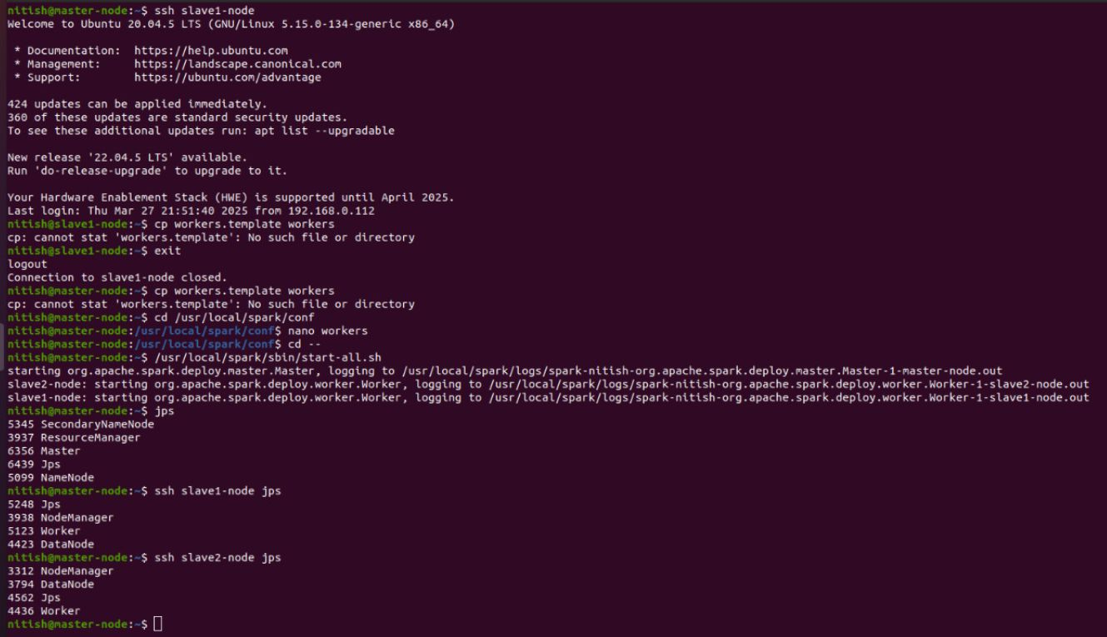

Slide 9
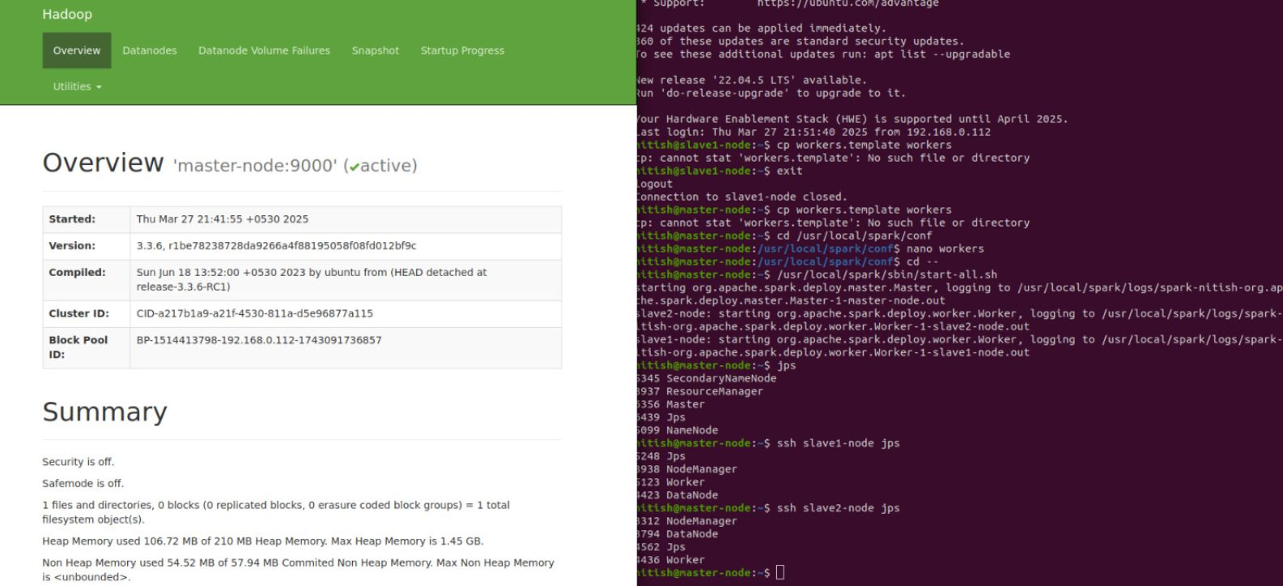

Slide 10
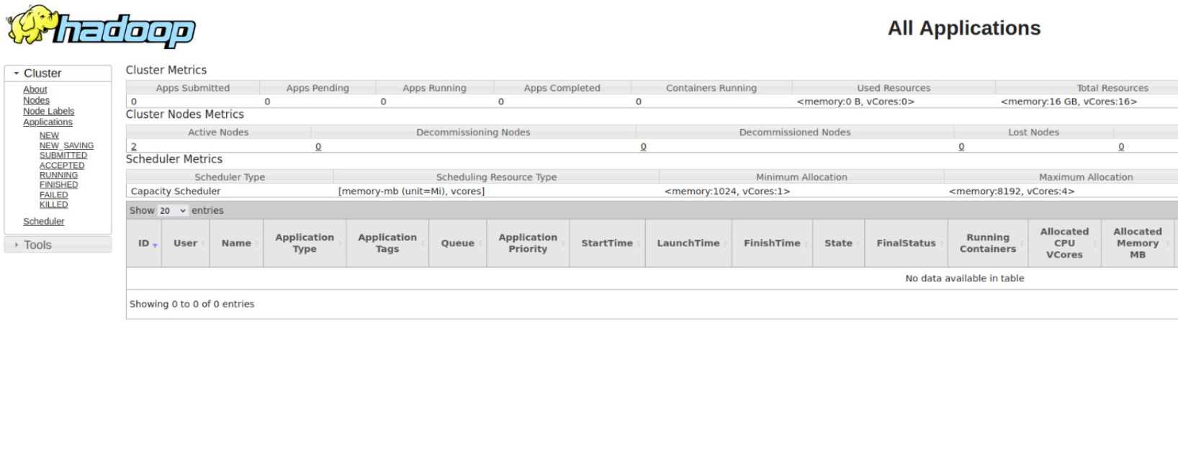

Slide 11
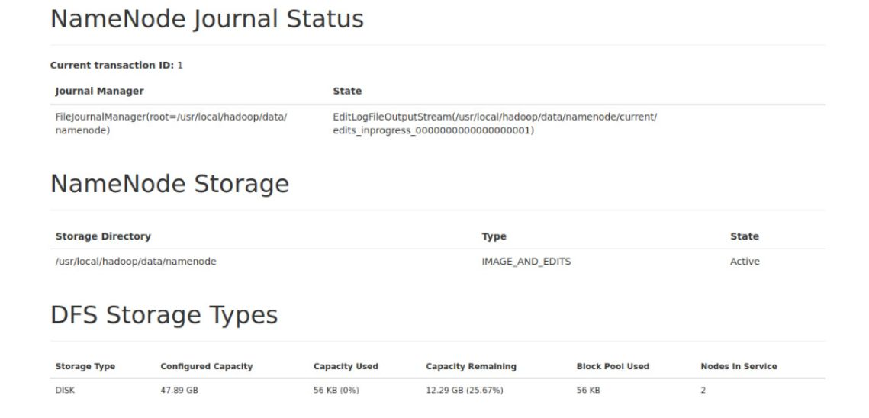

Slide 12
Initializing Spark Session
Content:
Purpose: Establish a connection to the Spark environment.
Key Feature: Enables scalable data processing for tweet analysis.

Slide 13
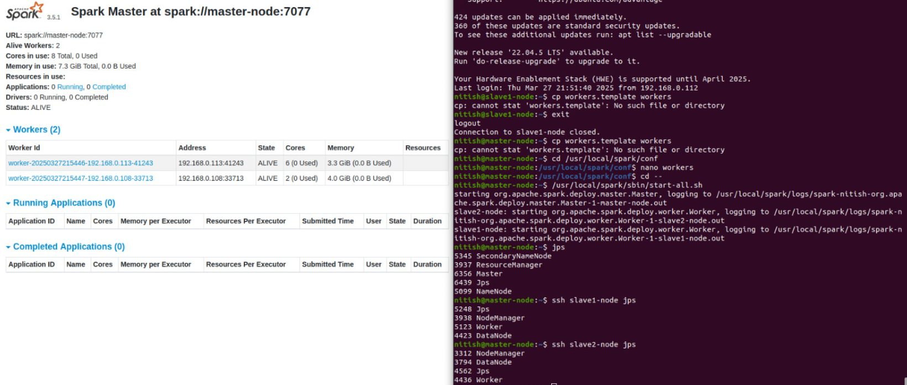

Slide 14
Integrating Jupyter Notebook
Steps:
Install Jupyter Notebook.
Set up integration with Spark.
Launch the notebook environment.
Run interactive analysis tasks.

Slide 15
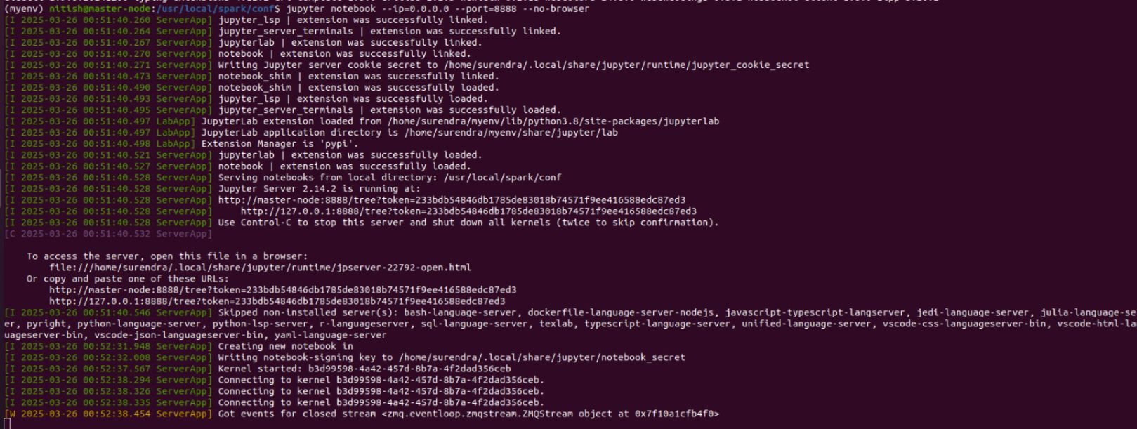

Slide 16
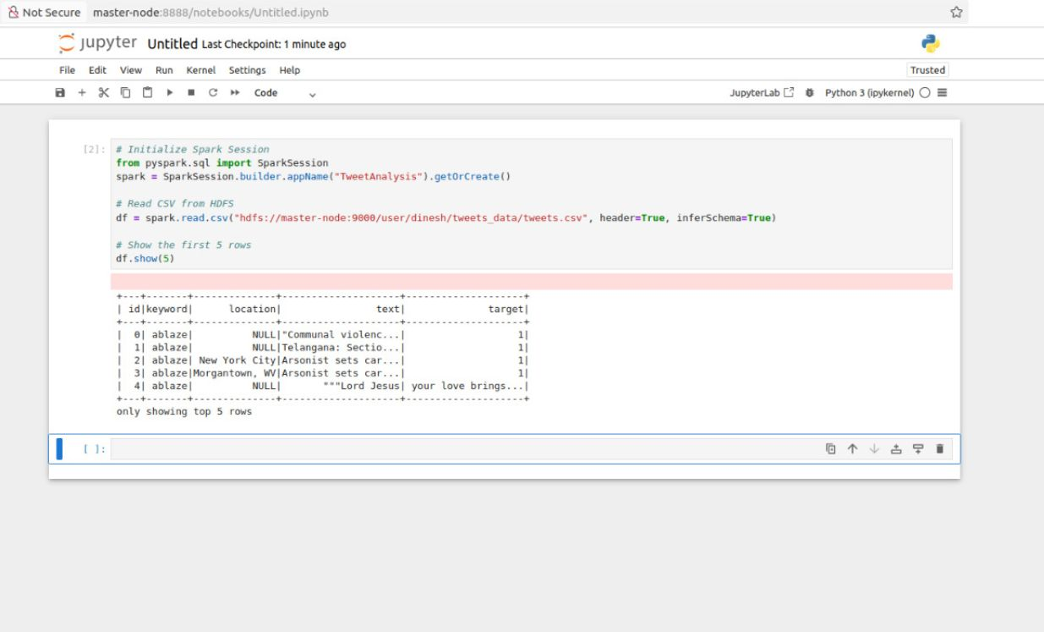

Slide 17
Working
Execution Flow:
Load dataset from storage.
Preprocess tweet content.
Extract key features.
Train and evaluate the model.
Identify disaster-related tweets.
Visualize key insights.

Slide 18
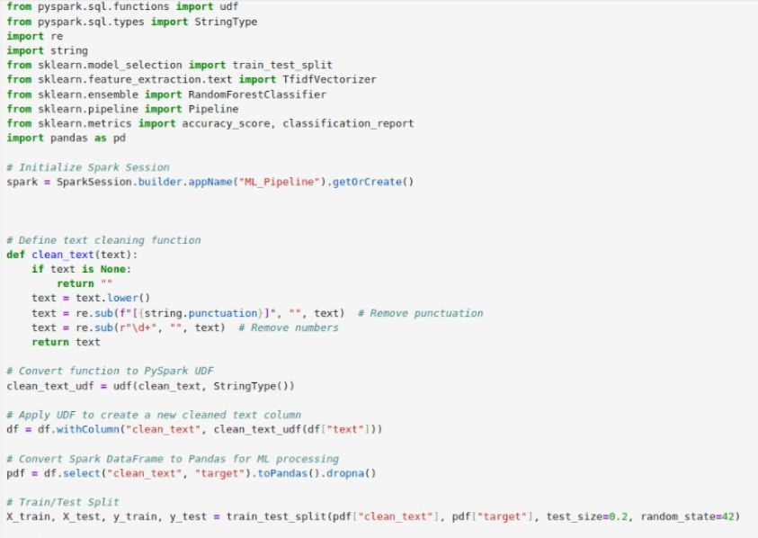
Preprocess for Training and Testing.

Slide 19
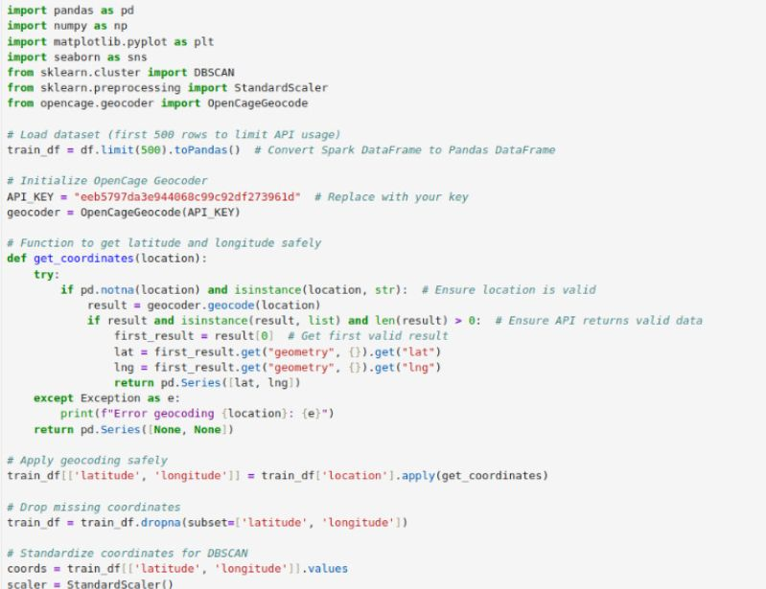
Geocoding for Spatial clustering.

Slide 20
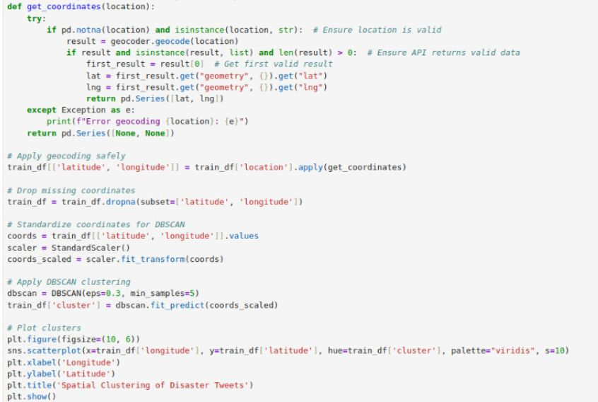

Slide 21
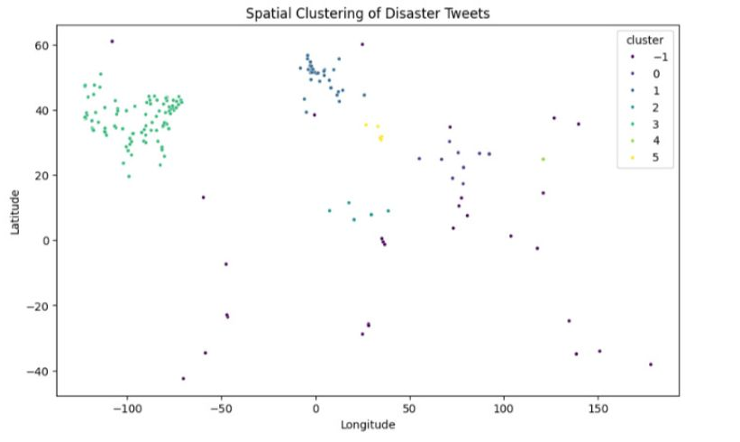
Spatial clustering

Slide 22
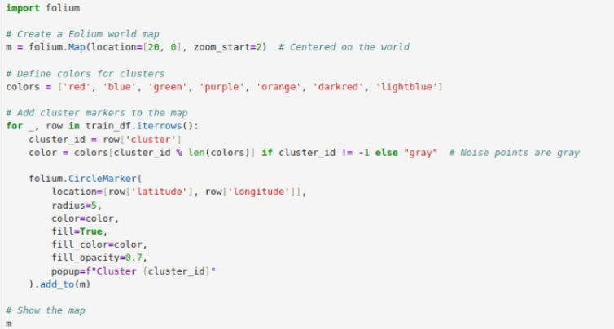
Spatial clustering on Map

Slide 23
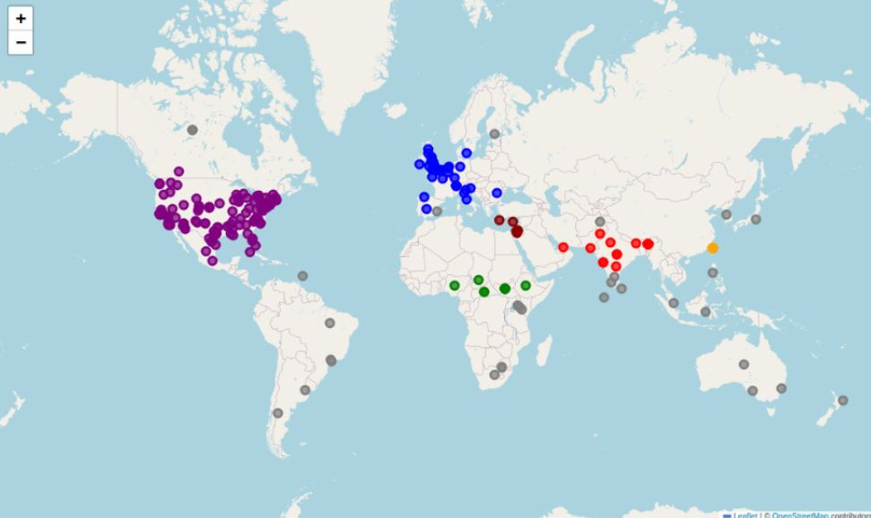
Spatial clustering on Map

Slide 24
Model Training and Predictions
Process:
Train the Model Using Random Forest classifier.
Assess model performance (accuracy, reliability).
Predict disaster-related tweets.

Slide 25
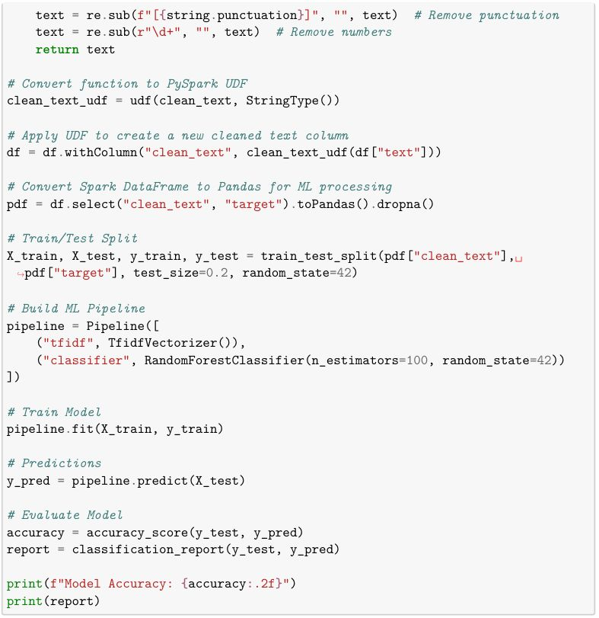
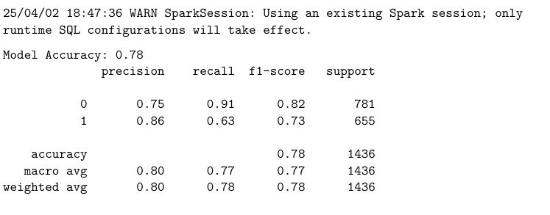
Model prediction and accuracy

Slide 26
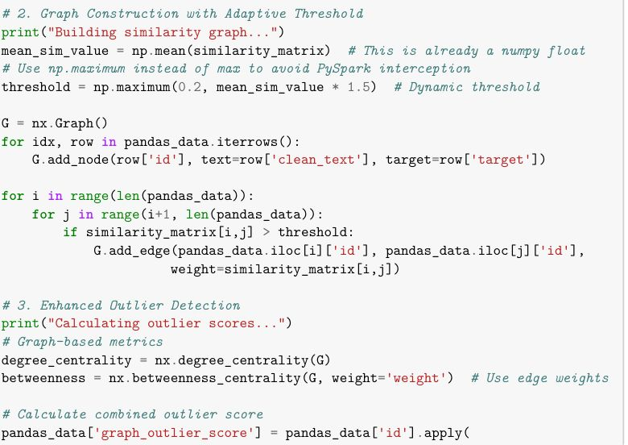
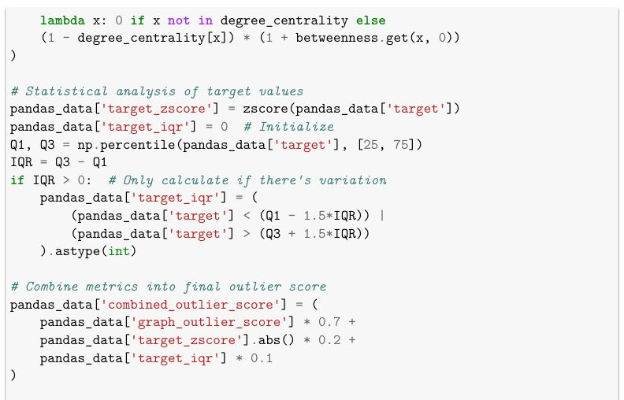
Spatial outlier detection

Slide 27
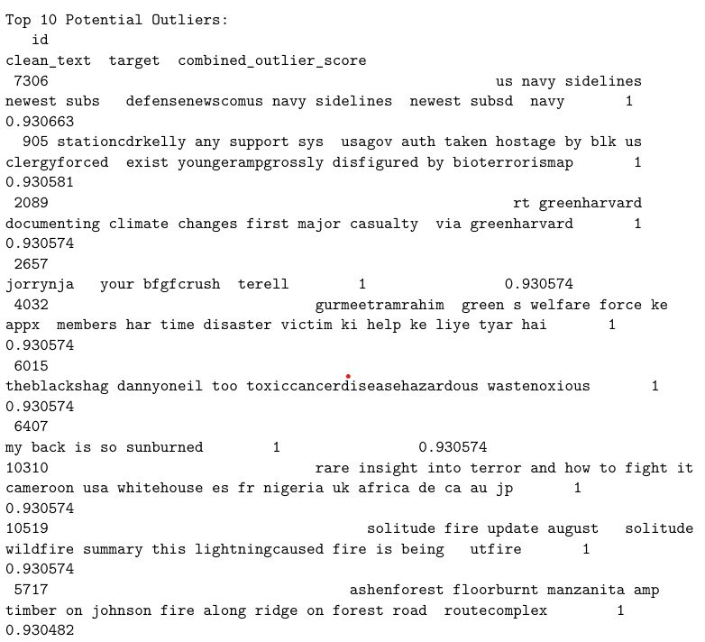
Spatial outlier detection

Slide 28
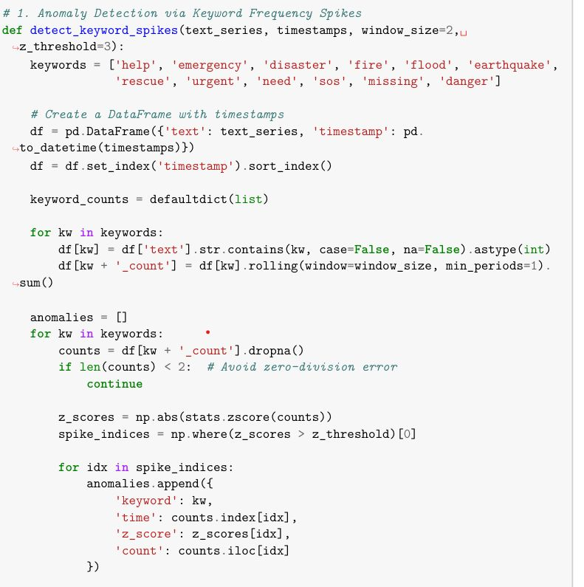
Anomalies Detection

Slide 29
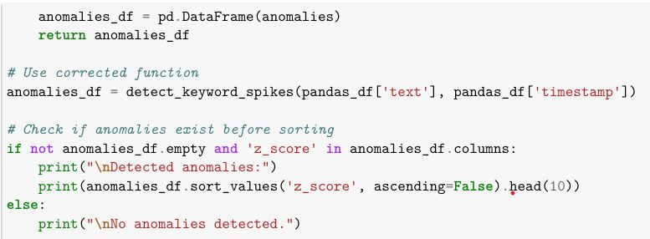
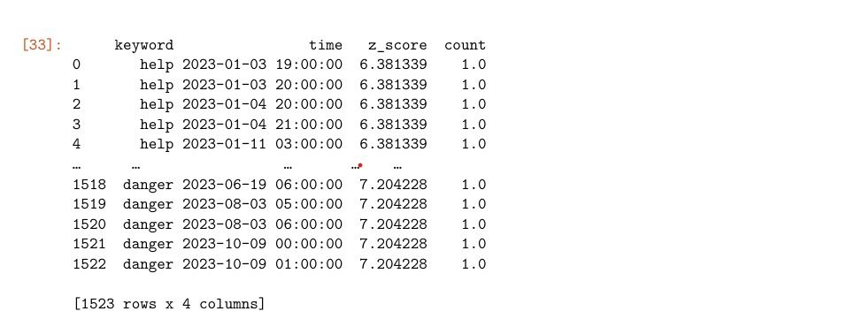
Anomalies Detection

Slide 30
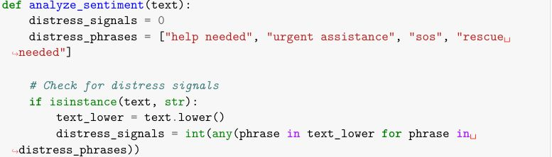
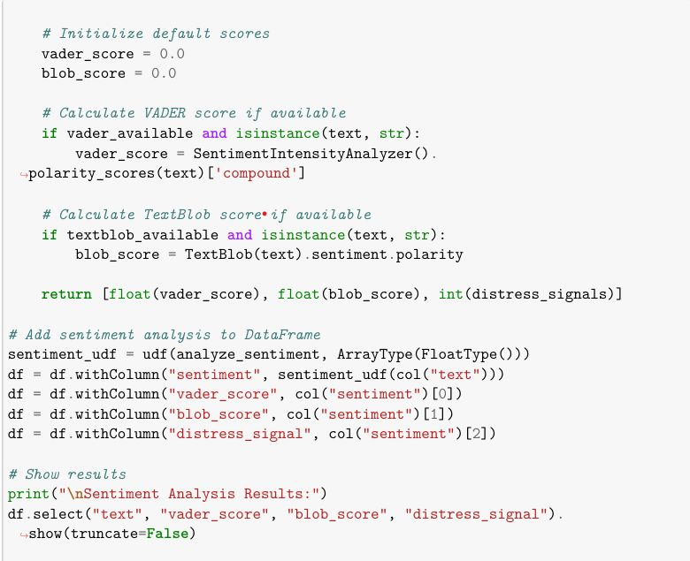
Sentiment Analysis

Slide 31
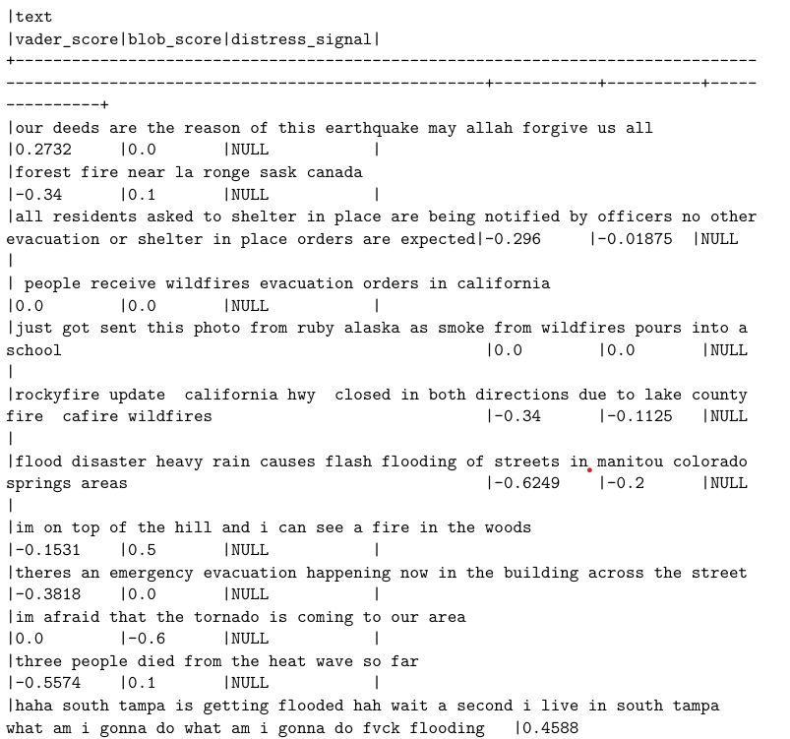
Sentiment Analysis

Slide 32
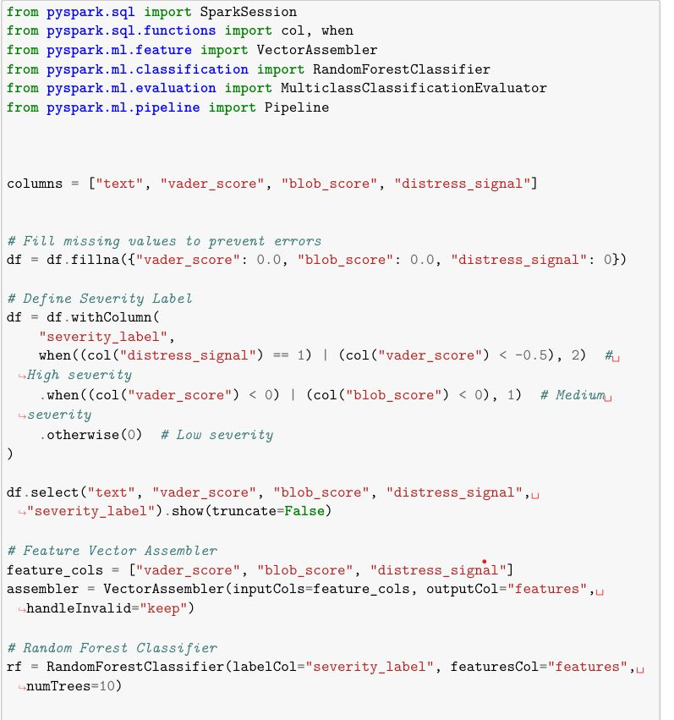
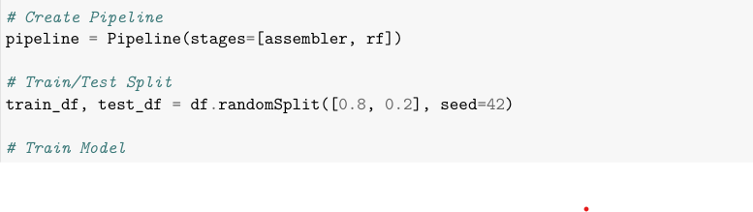
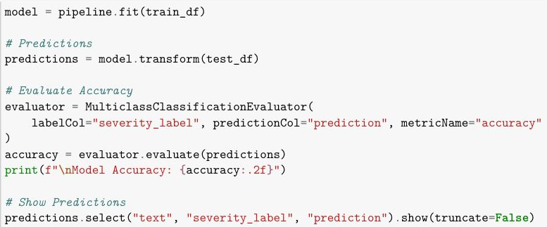
Classification model based on severity label

Slide 33
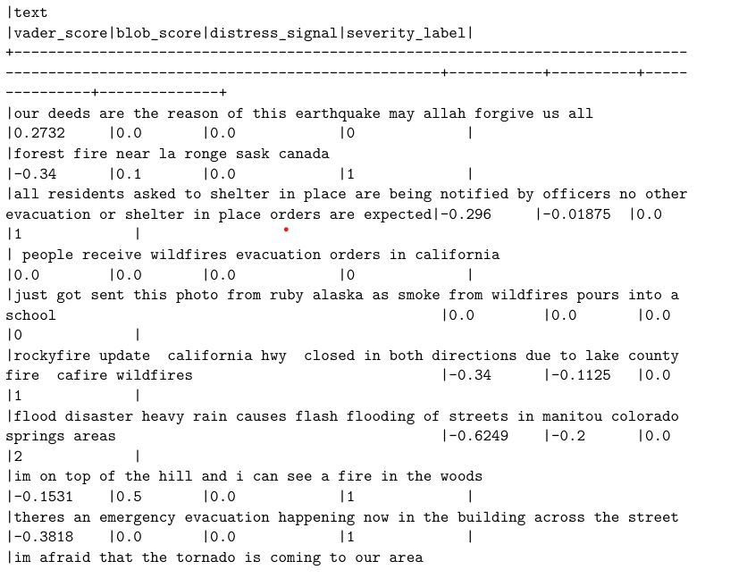
Classification model based on severity label

Slide 34
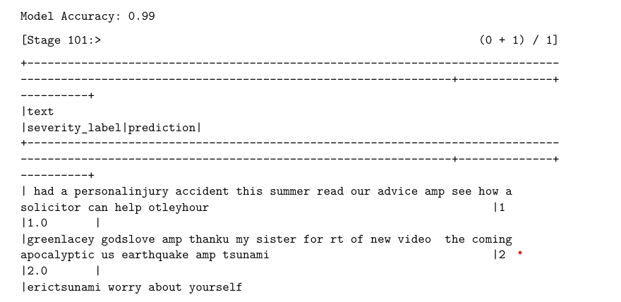
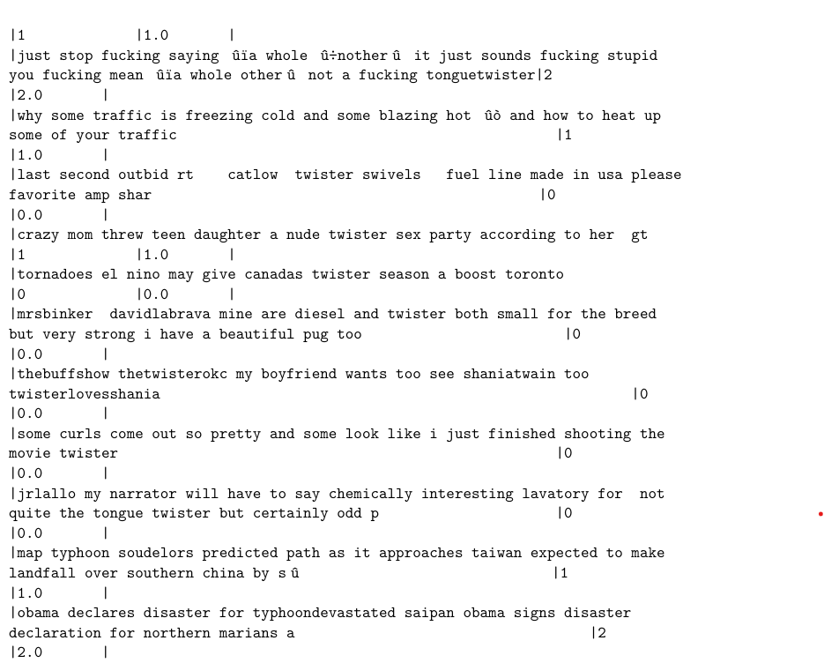
Classification model based on severity label

Slide 35
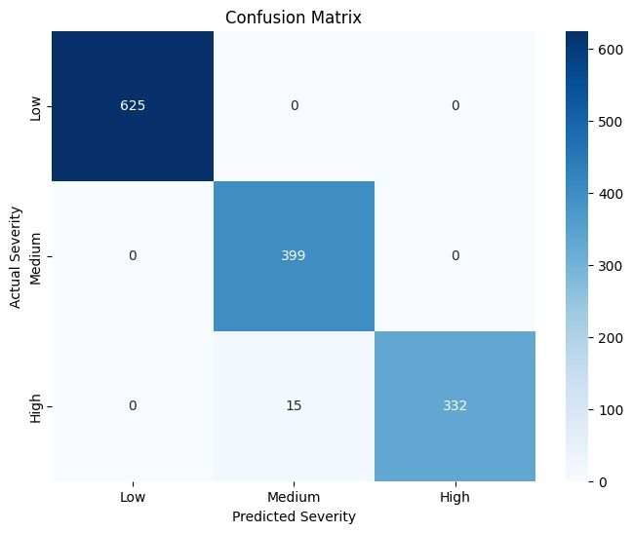
visualization

Slide 36
Individual Contributions of Group Members
As, it is a Master-Salve Architecture, we have kept Master-node on one PC, and 2 slave-nodes on remaining two PCs.
Manish -122AD0029, Contributed in Analyzing Sentimental Analysis and Predicting Sevararity of the tweet.
Dinesh – 122AD0041, Contributed in Pre-processing of Tweets and Fake Tweets Detection Using NLP.
Balasubramaniam – 122AD0048, Contributed in Spatial Tempo Analysis, Spatial Clustering and Visualization.

Slide 37
Challenges Faced During Implementation
Noisy and Unstructured Data Tweets often contain emojis, abbreviations, slang, URLs, and inconsistent formatting, making preprocessing a significant challenge. Removing noise without losing critical context was essential for accurate analysis.
Disaster vs. Non-Disaster Classification Differentiating between tweets that truly report a disaster and those that are metaphorical or unrelated required fine-tuned classification models. Misclassification could lead to incorrect alerts or missed warnings.
Geolocation Limitations A major obstacle was the lack of precise location data, as many users disable GPS tagging. Predicting tweet origin from indirect clues like hashtags, user profiles, and past interactions was both complex and computationally intensive.
Scalability and Performance Processing large-scale tweet datasets in real-time required effective use of Apache Spark's distributed computing. Setting up a multi-node cluster (1 Master, 2 Slaves) and ensuring performance optimization was technically demanding.
components like Spark, Jupyter, NLP libraries, and visualization tools into a seamless workflow involved troubleshooting compatibility and environment issues across different platforms.

Slide 38
Challenges Faced During Implementation
Data Ambiguity and Redundancy Duplicate tweets, misleading content, and vague information complicated the model’s reliability. Implementing NLP-based filtering and validation added an extra layer of complexity.
Sentiment Analysis Challenges Accurately capturing emotions like urgency or distress from short texts posed a difficulty. Mapping emotional tone to disaster severity required careful feature selection and interpretation.
System Integration Combining components like Spark, Jupyter, NLP libraries, and visualization tools into a seamless workflow involved troubleshooting compatibility and environment issues across different platforms.

Slide 39
Conclusion
This project successfully demonstrated a scalable and efficient framework for detecting and analyzing disaster-related tweets using big data technologies and natural language processing. By integrating Apache Spark with machine learning models, the system effectively classified tweets, performed spatial clustering to identify affected regions, and evaluated sentiment to understand the severity of situations. Despite challenges such as noisy data, location inaccuracies, and sentiment ambiguity, the system provided meaningful insights that can aid in real-time disaster response and awareness.
The use of a distributed Spark cluster significantly improved the performance of data processing, and the classification model, supported by Random Forest, showed promising accuracy in detecting disaster-related content. Additionally, the visualizations provided intuitive representations of tweet trends, locations, and emotional tones.

Slide 40
Future Work
Mobile and Web Dashboards Developing user-friendly interfaces for stakeholders (e.g., disaster management authorities) can help visualize alerts, locations, and sentiments more effectively in real-time.
Integration with Government/NGO Systems Linking the analytics platform with emergency response systems can facilitate timely decision-making and aid distribution based on detected needs and severities.
Advanced Geo-Inference Techniques Implementing deep learning models or user-profile-based heuristics can further enhance location prediction accuracy for tweets lacking geo-tags.
Multilingual Tweet Processing Expanding NLP capabilities to handle tweets in regional languages would improve the system's inclusiveness and accuracy in diverse linguistic environments.

Slide 41
References
Apache Spark Documentation
Machine Learning with PySpark
Natural Language Processing with Python
Project Paper: Social Media Disaster Situation Awareness
IEEE

